Slide 1

Intrusion Detection System
Anne Carmel
MCA II A
KGiSL Institute of Management
Project guided by
Dr.C.Sathya
Assistant Professor

Slide 2
Objective of Proposed Work
Real-Time Threat Detection
Anomaly Detection using Machine Learning
Comprehensive Network Traffic Analysis
Visualization & Monitoring
Automated Altering & Reporting
Scalability & Flexibility
Integration with Existing Security Infrastructure
Educational Value & Practical Application
Compliance & Security Standards
Documentation & Training

Slide 3


Slide 4
Background Study
Network Security Overview:
- Critical for protecting network infrastructure from unauthorized access and cyber threats.
- Intrusion detection plays a key role in identifying potential security breaches.
Intrusion Detection Systems (IDS):
Types:
- Network-based IDS (NIDS): Monitors network traffic.
- Host-based IDS (HIDS): Monitors activities on individual devices.
Detection Approaches:
- Signature-based: Identifies known threats using a database of signatures.
- Anomaly-based: Detects deviations from normal behavior.
Evolution of IDS:
- Early systems were signature-based, limited to known threats.
- Modern IDS use anomaly-based detection and machine learning for advanced threat detection.

Slide 5
Background Study
Machine Learning in IDS:
- Enhances detection by analyzing patterns in network traffic.
- Techniques: Supervised learning (e.g., Decision Trees) and Unsupervised learning (e.g., clustering).
Key Tools and Technologies:
- Snort: Open-source NIDS for real-time traffic analysis.
- Suricata: High-performance NIDS/NIPS/NSM engine.
- ELK Stack: For ingesting, analyzing, and visualizing security data.
- Grafana: Monitoring and visualization tool.
- Machine Learning Libraries: Scikit-learn, TensorFlow, PyTorch for model development.

Slide 6
Background Study
Challenges:
- Balancing false positives and false negatives.
- Ensuring scalability to handle increasing network traffic.
- Addressing evasion techniques used by attackers.
Applications:
- Deployed in enterprises, government agencies, financial institutions for protecting sensitive data.
- Essential for detecting advanced threats and ensuring compliance with security regulations.

Slide 7
Fact Findings – Background Study
Network Security Importance:
Cybercrime costs are expected to reach $10.5 trillion annually by 2025, emphasizing the need for robust network security measures, including IDS.
History of IDS:
The concept of intrusion detection was first introduced in the early 1980s by James Anderson, who emphasized the need for security monitoring in computer systems.
Types of IDS:
Network-based IDS (NIDS) monitors network traffic at the packet level.
Host-based IDS (HIDS) operates on individual hosts or devices, monitoring file integrity, system logs, and more.
Detection Approaches:
Signature-based IDS can quickly detect known threats with high accuracy but struggles with novel attacks (zero-day vulnerabilities).
Anomaly-based IDS can detect previously unknown threats but may generate more false positives.

Slide 8
Fact Findings – Background Study
Evolution with Machine Learning:
Modern IDS integrates machine learning to improve detection accuracy. For example, anomaly detection algorithms can reduce false positives by up to 70%.
Challenges in IDS:
False positives are a significant challenge, with some systems generating hundreds of alerts daily, many of which may be benign.
Scalability issues arise as networks grow, with high-speed networks requiring IDS that can process vast amounts of data in real-time.
Current Trends:
The adoption of AI and ML in IDS is growing, with AI-driven IDS systems expected to dominate the market by 2025.
The global IDS market is projected to grow from $4.1 billion in 2021 to $5.9 billion by 2026, driven by the increasing complexity of cyber threats.

Slide 9



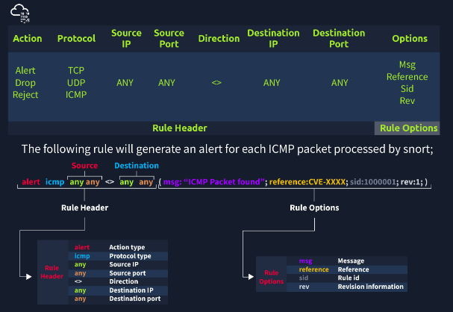
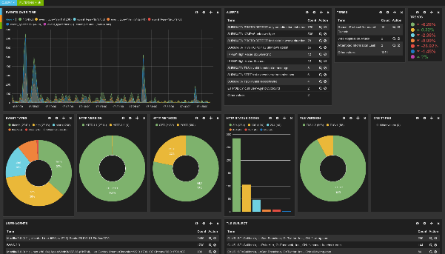

Fact Findings – Background Study
Tools Used in IDS:
Snort: One of the most widely used open-source NIDS, capable of analyzing traffic in real-time.
Suricata: A multi-threaded IDS that can also function as an intrusion prevention system (IPS).
ELK Stack: Popular in IDS for log management, search, and data visualization.

Slide 10
Proposed System
System Overview:
The proposed Intrusion Detection System (IDS) is designed to monitor and analyze network traffic in real-time, detecting unauthorized access, suspicious activities, and potential security breaches. It will leverage both signature-based and anomaly-based detection techniques to provide comprehensive coverage against known and unknown threats.
Architecture and Components:
Network Sensors: Deployed across critical points in the network to capture and monitor all incoming and outgoing traffic.
Detection Engine: The core of the IDS, utilizing both signature-based and anomaly-based detection methods. The detection engine will use a database of known attack signatures and machine learning algorithms to identify anomalies.

Slide 11
Proposed System
Data Storage: A secure, centralized database to store logs, detected events, and historical data for further analysis and reporting.
User Interface: A web-based dashboard that provides real-time visualization, alerts, and detailed reports on detected threats, allowing security personnel to respond promptly.
Alert System: Automated alerts will be generated when a potential threat is detected, notifying the security team via email, SMS, or integration with existing security information and event management (SIEM) systems.

Slide 12
Proposed System
Key Features:
Real-Time Monitoring: Continuous monitoring of network traffic to detect intrusions as they occur.
Anomaly Detection: Machine learning models will be employed to learn normal network behavior and detect deviations that may indicate a security breach.
Signature-Based Detection: The system will compare network traffic against a database of known threat signatures, ensuring rapid detection of familiar attack patterns.
Visualization and Reporting: Interactive dashboards and detailed reports will help administrators track network health, analyze detected threats, and assess the overall security posture.
Scalability: The system will be designed to scale with network growth, ensuring consistent performance and coverage even in high-traffic environments.

Slide 13
Proposed System
Technologies and Tools:
Snort/Suricata: Used for network traffic analysis and signature-based detection.
Machine Learning Libraries (e.g., Scikit-learn, TensorFlow): Employed for building and training anomaly detection models.
ELK Stack (Elasticsearch, Logstash, Kibana): Utilized for log management, data analysis, and visualization.
Grafana: For creating real-time monitoring dashboards.
MySQL/PostgreSQL: Databases for storing logs and historical data.
Integration and Deployment:
The IDS will be integrated with existing network infrastructure, including firewalls and SIEM systems, to provide a holistic security solution. Deployment can be virtual or on-premises, depending on the network environment.
User Experience:
Security personnel will interact with the IDS through an intuitive web interface, allowing them to monitor network activity, investigate alerts, and generate reports. The system will be designed with ease of use in mind, enabling quick adoption and efficient operation.

Slide 14
Advantages of Proposed System
1. Real-Time Threat Detection
2. Comprehensive Coverage
3. Scalability
4. Automated Alerts and Notifications
5. Enhanced Visibility and Reporting
6. Ease of Integration
7. Machine Learning Capabilities
8. Cost-Effective Security Solution
9. Centralized Data Management
10. Improved Network Performance

Slide 15
Module Details
Network Sensors Module:
Function: Captures and monitors network traffic from various points within the network.
Components: Network taps, packet sniffers.
Technology: Interfaces with Snort/Suricata for traffic analysis.
Detection Engine Module:
Function: Analyzes captured traffic using both signature-based and anomaly-based detection methods.
Components: Signature database, anomaly detection algorithms.
Technology: Uses machine learning libraries (e.g., Scikit-learn, TensorFlow) for anomaly detection and pattern recognition.
Data Storage Module:
Function: Stores logs, detected events, and historical data.
Components: Centralized database.
Technology: Utilizes MySQL/PostgreSQL for relational database management.

Slide 16
Module Details
User Interface Module:
Function: Provides a web-based dashboard for monitoring, visualizing, and managing security data.
Components: Web server, user authentication, data visualization tools.
Technology: Implements frameworks like React or Angular for the frontend and Node.js or Django for the backend.
Alert System Module:
Function: Generates and manages real-time alerts for detected threats.
Components: Notification system, alert rules configuration.
Technology: Integrates with email/SMS services or SIEM systems for alert distribution.
Visualization and Reporting Module:
Function: Offers interactive dashboards and detailed reports on network security status and detected threats.
Components: Graphs, charts, and report generation tools.
Technology: Uses ELK Stack (Elasticsearch, Logstash, Kibana) and Grafana for data visualization.

Slide 17
Module Details
Integration Module:
Function: Ensures seamless integration with existing network infrastructure and security tools.
Components: API interfaces, integration connectors.
Technology: Supports integration with existing SIEM systems and firewalls.
Machine Learning Model Module:
Function: Trains and deploys machine learning models for anomaly detection and predictive analytics.
Components: Model training, model deployment.
Technology: Employs machine learning frameworks (e.g., TensorFlow, PyTorch) for model development.

Slide 18

Conclusion

